Slide 1



Predicting Heart Diseases In Medical Patients
The Society

Slide 2
Process Methods
02. Logistic Regression
04. Visualize Model Errors
01. Data Visualization
03. Data Balancing
05. Random Forest Classifier
Notes:
This template was inserted from Power-user, the productivity add-in for PowerPoint, Excel and Word.
Install Power-user to access thousands of templates, icons, maps, diagrams and charts with Power-user.
Visit https://www.powerusersoftwares.com/
©Power-user SAS, terms of license: https://www.powerusersoftwares.com/terms

Slide 3
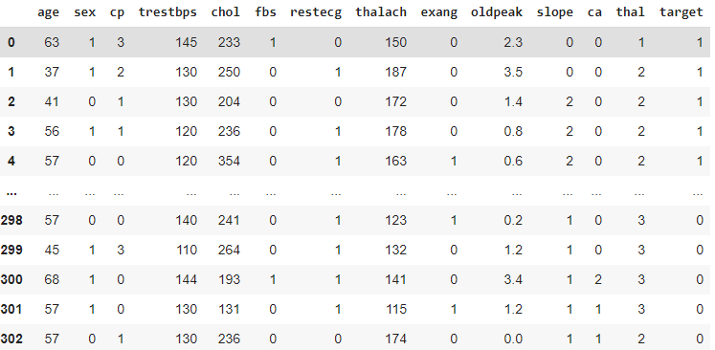
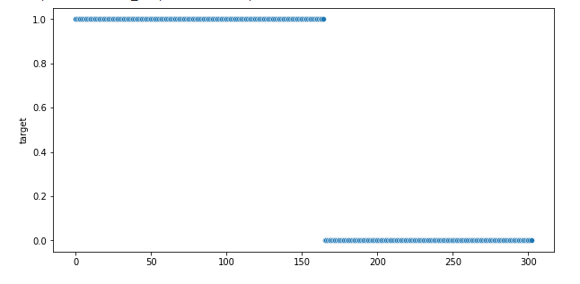
Data Visualization
Loren Sporem Koreama
Don Za La conapan
Drake OvO
Notes:
This template was inserted from Power-user, the productivity add-in for PowerPoint, Excel and Word.
Install Power-user to access thousands of templates, icons, maps, diagrams and charts with Power-user.
Visit https://www.powerusersoftwares.com/
©Power-user SAS, terms of license: https://www.powerusersoftwares.com/terms

Slide 4
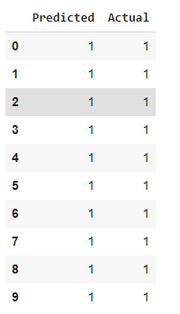
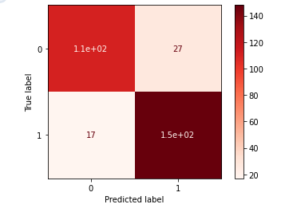
Logistic Regression
Loren Sporem Koreama
Don Za La conapan
Drake OvO
Notes:
This template was inserted from Power-user, the productivity add-in for PowerPoint, Excel and Word.
Install Power-user to access thousands of templates, icons, maps, diagrams and charts with Power-user.
Visit https://www.powerusersoftwares.com/
©Power-user SAS, terms of license: https://www.powerusersoftwares.com/terms

Slide 5
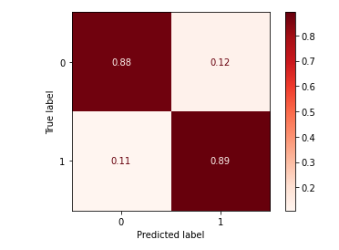
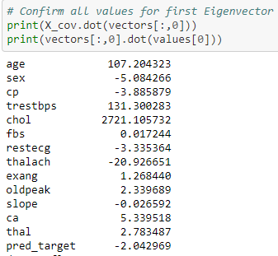
Random Forest Classifier
300 Estimators counted
Don Za La conapan
Drake OvO
- X_Test Confusion Matrix
Notes:
This template was inserted from Power-user, the productivity add-in for PowerPoint, Excel and Word.
Install Power-user to access thousands of templates, icons, maps, diagrams and charts with Power-user.
Visit https://www.powerusersoftwares.com/
©Power-user SAS, terms of license: https://www.powerusersoftwares.com/terms

Slide 6
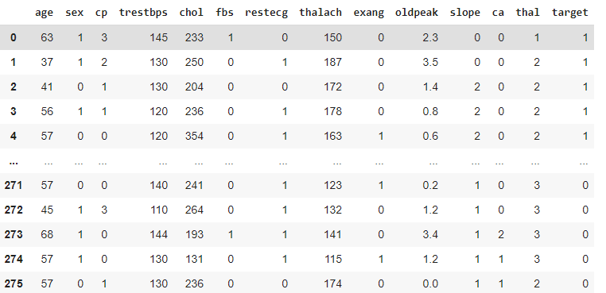
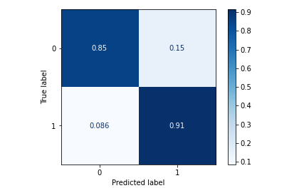
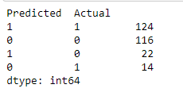
Data Balancing
Loren Sporem Koreama
Don Za La conapan
Drake OvO
Notes:
This template was inserted from Power-user, the productivity add-in for PowerPoint, Excel and Word.
Install Power-user to access thousands of templates, icons, maps, diagrams and charts with Power-user.
Visit https://www.powerusersoftwares.com/
©Power-user SAS, terms of license: https://www.powerusersoftwares.com/terms

Slide 7
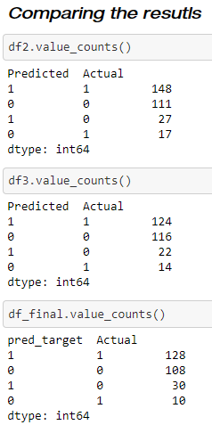
Visualize Model Errors
Notes:
This template was inserted from Power-user, the productivity add-in for PowerPoint, Excel and Word.
Install Power-user to access thousands of templates, icons, maps, diagrams and charts with Power-user.
Visit https://www.powerusersoftwares.com/
©Power-user SAS, terms of license: https://www.powerusersoftwares.com/terms

Slide 8
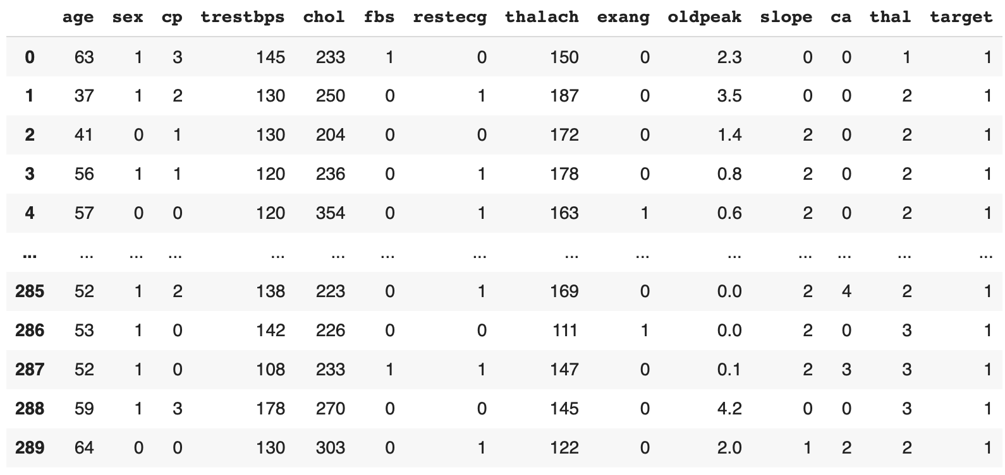
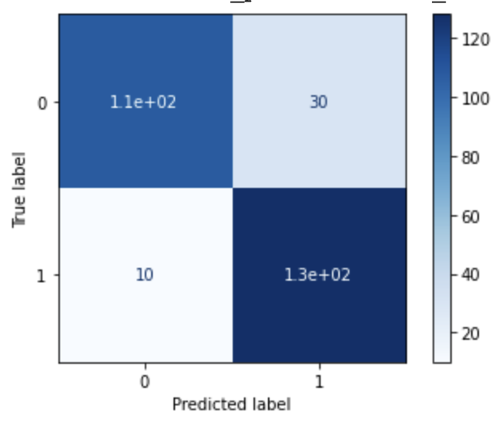
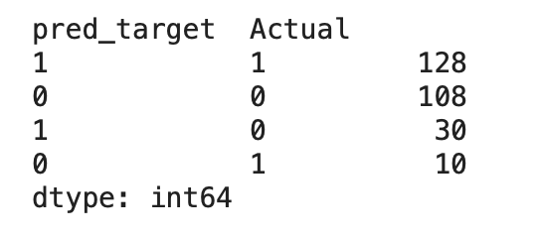
Reducing Errors

Slide 9
Conclusion
Notes:
This template was inserted from Power-user, the productivity add-in for PowerPoint, Excel and Word.
Install Power-user to access thousands of templates, icons, maps, diagrams and charts with Power-user.
Visit https://www.powerusersoftwares.com/
©Power-user SAS, terms of license: https://www.powerusersoftwares.com/terms

